Slide 1
Customer Churn Report
- Dhivyesh r k
3RD YEAR b.Tech CSE student
IIIT Kottayam

Slide 2
Data Cleaning Documentation
The data consists of 7032 rows and 27 columns/features and one target variable “Churn”.
A ‘yes’ indicates the customer no longer stayed. ‘No’ indicates otherwise
There are 11 columns where Tenure of the customer is zero, Churn is no and Total Charges incurred from the customer is missing.
We drop these 11 columns
Except MonthlyCharges, TotalCharges and tenure, all data is categorical.
Convert them to Numeric features using LabelEncoder

Slide 3
Label Encoding may introduce incorrect information through unintended ordinality implying a relationship among features though none exists.
One Hot Encoding introduces higher dimensionality into the data.
Here, Label Encoding is used because Random Forest and other tree based algorithms are not sensitive to the ordinality.
We use a train test split of 70:30 here.
The distribution of the numeric features are over many range values.
We scale them from 0 to 1 using z-score normalization technique.

Slide 4
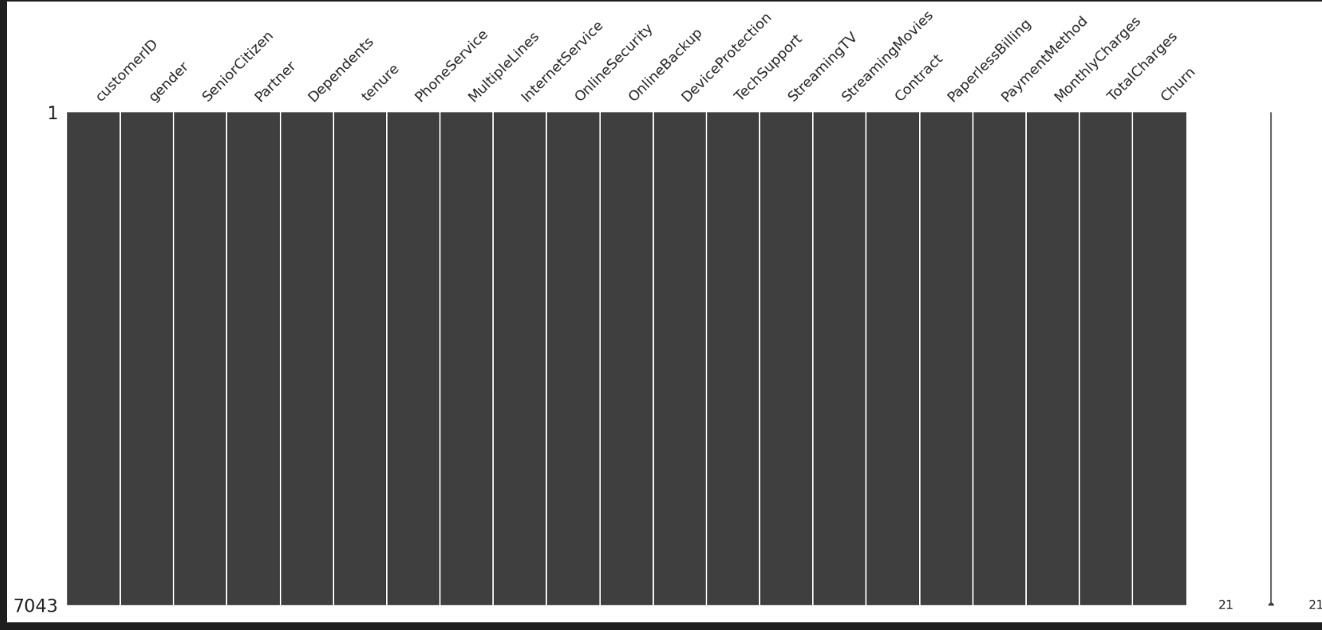
EDA & Insights
Checking for Null Values
There aren’t any null values visible here.
But however, after converting them to
numeric values, we see 11 rows with
the TotalCharges column having NaN.
Also, the tenure column contains all 0.
This refers to customers who didn’t opt for any plan and didn’t leave the company either.
These customers don’t contribute to any profit to the company.
Therefore we drop these rows.

Slide 5
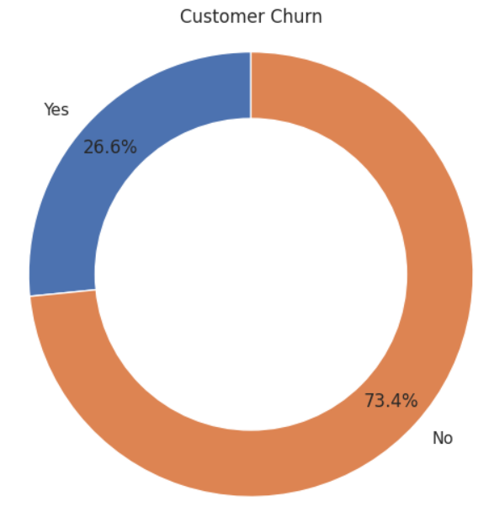
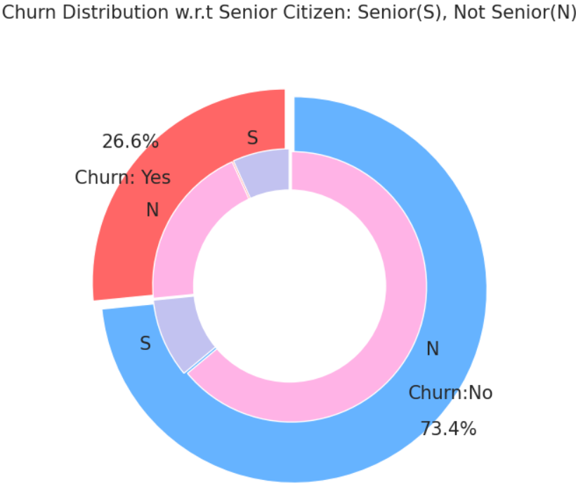
A larger portion of customers who have left are senior citizens than those who have stayed are senior citizens.
The company is able to retain 73.4% of its customers

Slide 6
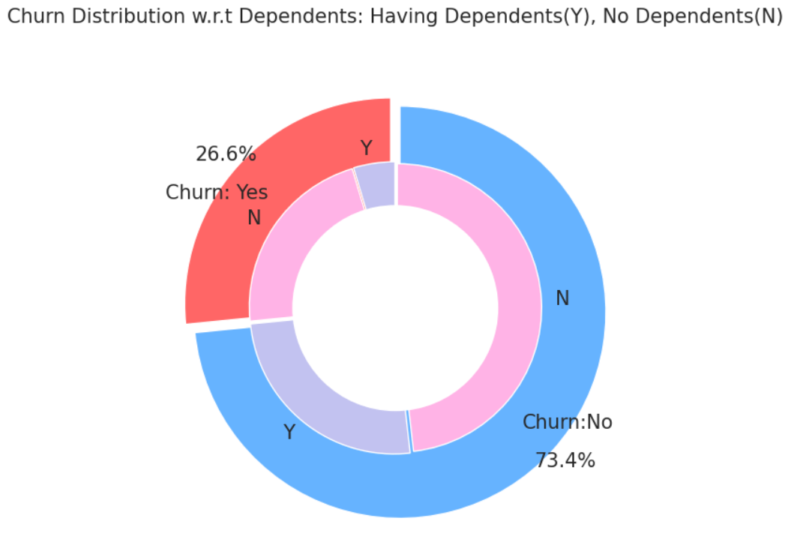
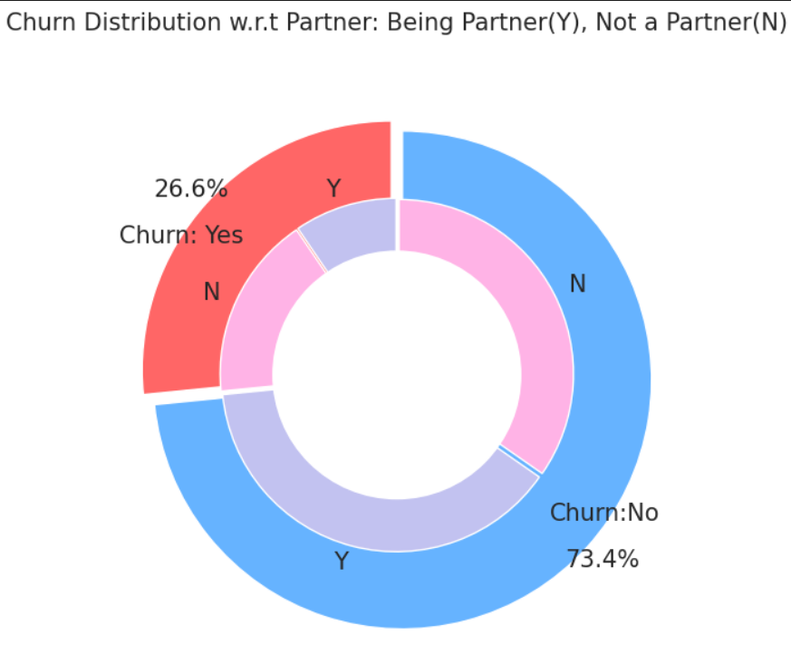
Customers who have dependents tend to be a little more loyal to the company.
Customers who are partners are more loyal to the company.
The company can reduce the cost of becoming a partner to help reduce customer churn.

Slide 7
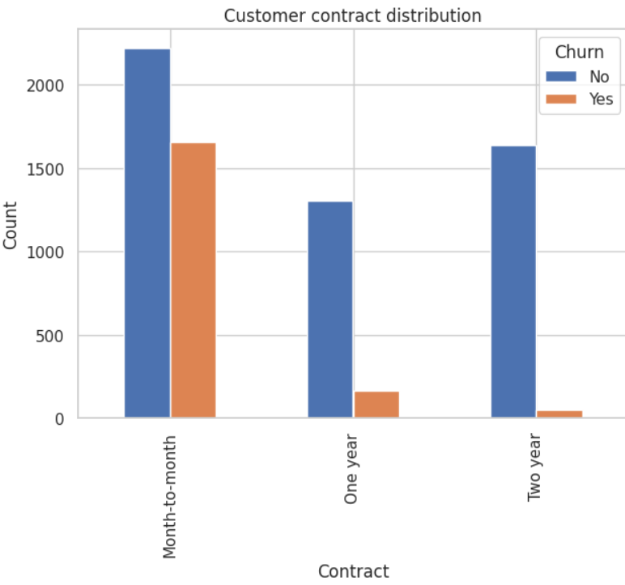
Number of customers with a one-year contract who stay is significantly larger than those with month-to-month contract.
~70% customers with month-to-month contract leave the company.
<15% customers with one-year contract leave
<4% customers with two-year contract leave

Slide 8
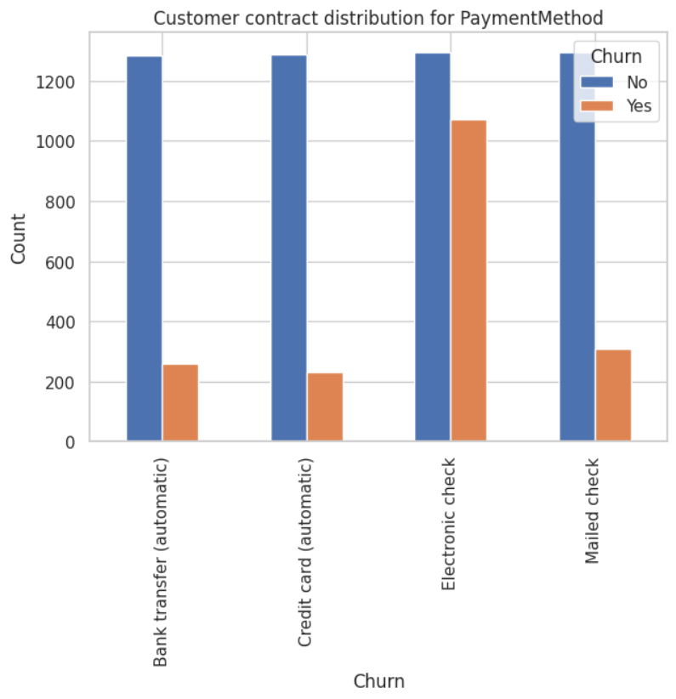
~82% of customers who pay using Electronic Check left the company
<17% of customers who pay using Credit Card automatically left the company.
<18% of customers who pay using Bank Transfer automatically left the company.
23% of customers who pay using Mailed Check left the company.
Company should encourage Bank Transfer and Credit Card payment modes to retain customers

Slide 9
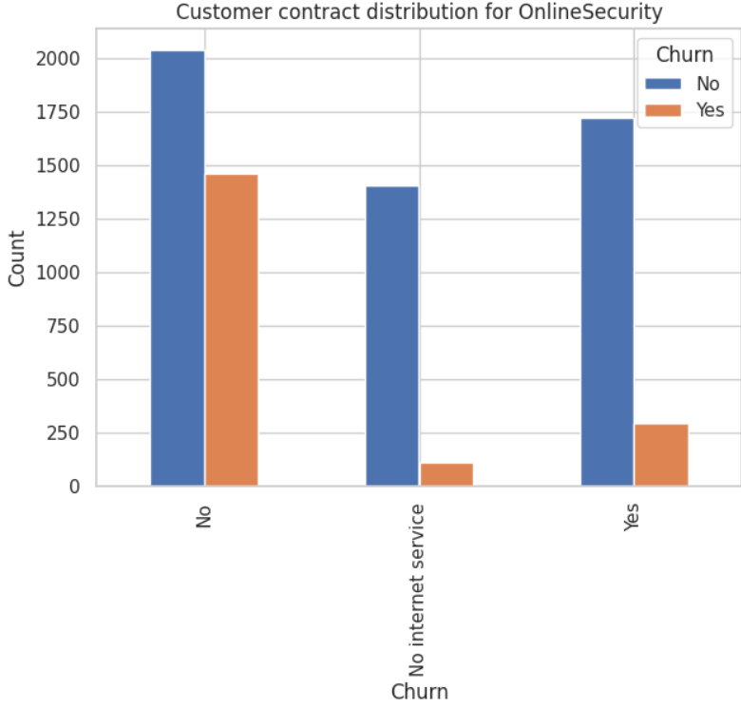
~72% customers who had an internet service and opted for No Online Security left.
~7% customers who didn’t have an internet service left.
17% customers who opted for Online Security stayed.
Company should encourage customers to take up online security to reduce customer churn

Slide 10
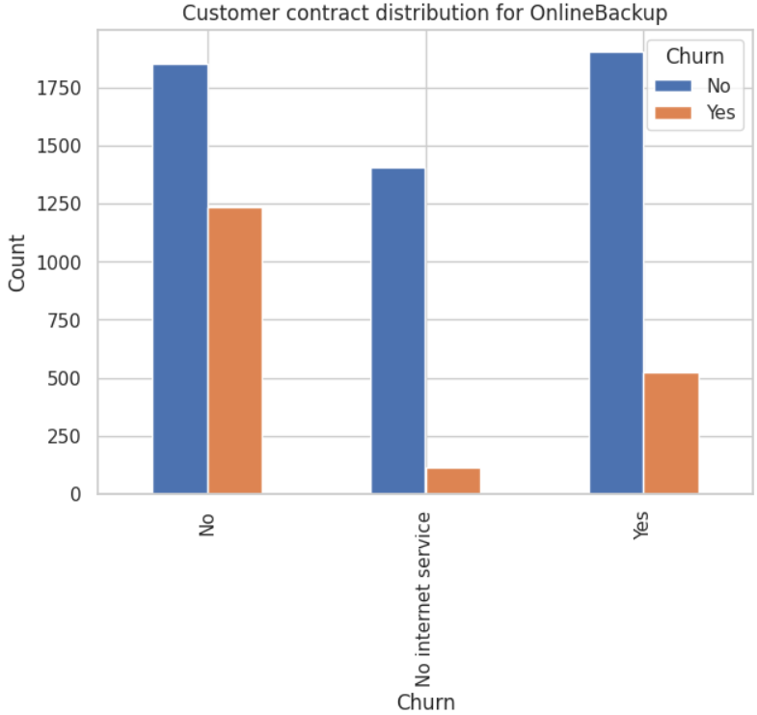
~ 64% customers who didn’t opt for Online Backup left.
~7% customers who don’t have an internet service left.
~26% customers who opted for Online Backup left.
Company should encourage customers to take up Online Backup to reduce customer churn

Slide 11
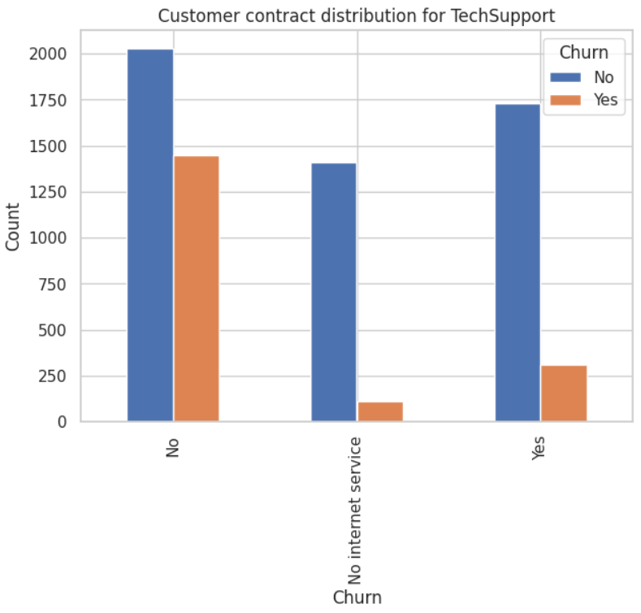
~70% customers who didn’t opt for Technical Support left.
17% customers who opted for Technical Support left.
Company should encourage customers to take up tech support feature or include it by default to reduce customer churn

Slide 12
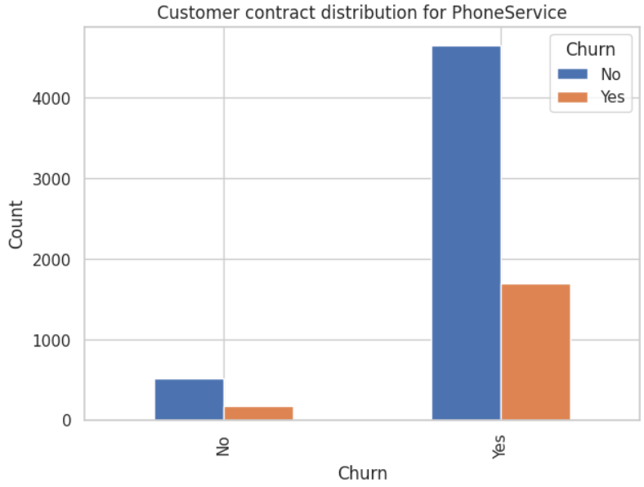
~35% of customers who didn’t opt for Phone Service left.
~36% of customers who opted for Phone Service left.
No correlation between phone service and customer churn rate

Slide 13
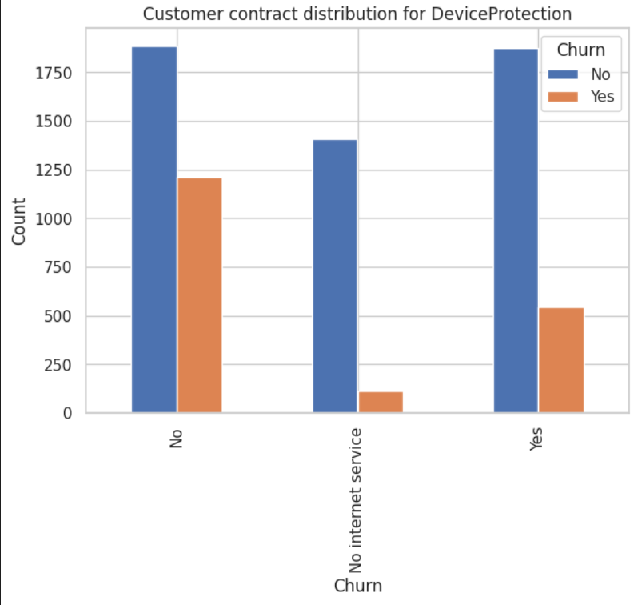
~64% of Customers who didn’t opt for Device Protection left.
29% of customers who opted for Device Protection churned.
Company should encourage customers to take up Device Protection to reduce customer churn

Slide 14
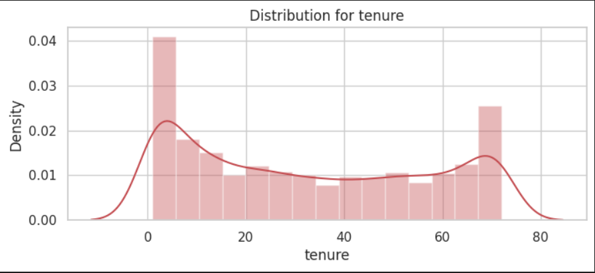
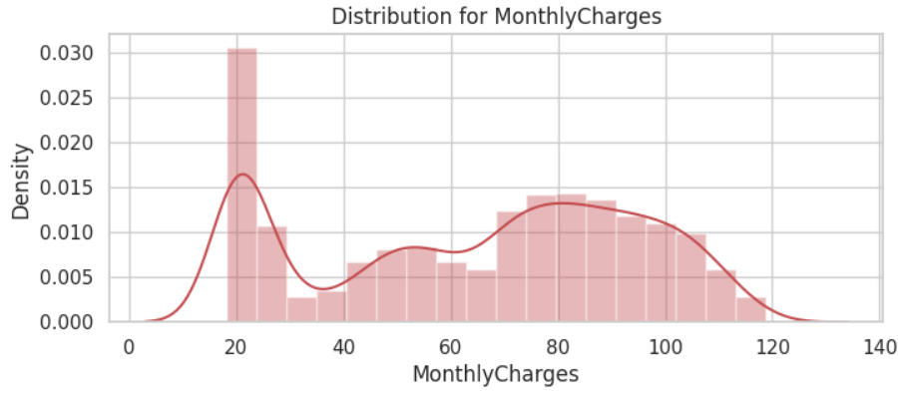
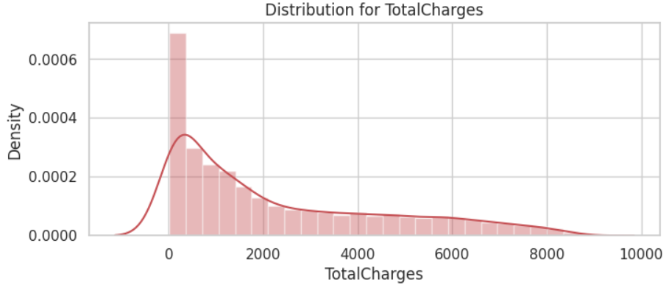
Distribution of Data
Data is vastly spread over multiple range of values.
Normalize the data using z-score normalization. (plots in next page)

Slide 15
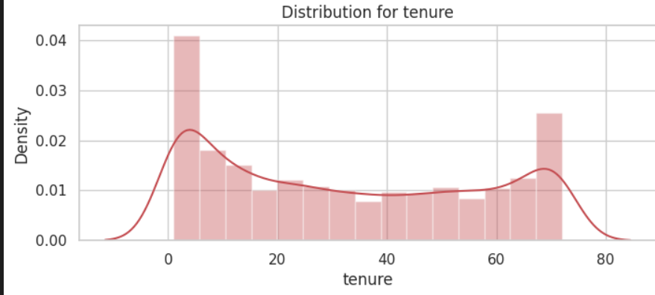
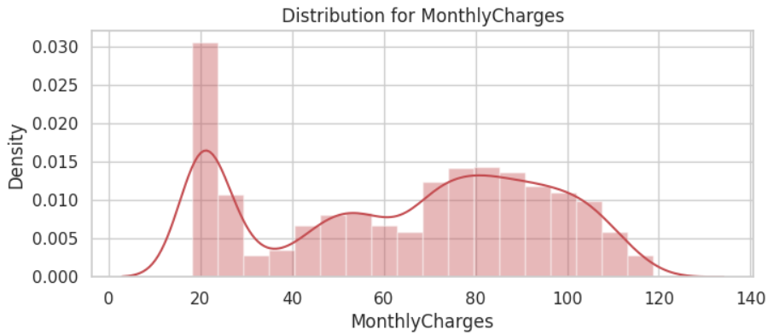

z-score normalized data

Slide 16
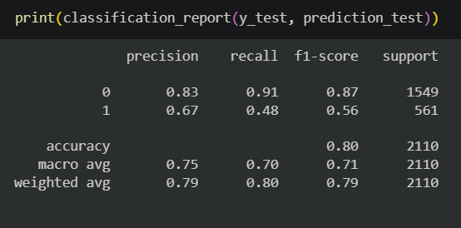
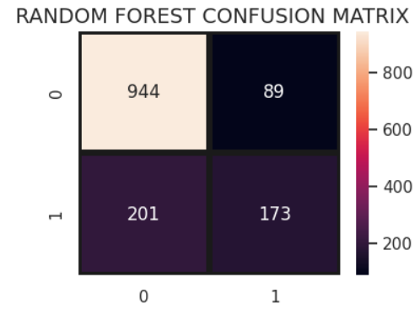
Model Building
Random Forest model with 5000 estimators, max number of features less than square root of total features and not more than 50 leaf nodes yields 79.8 % accuracy.
Test size is taken as 30% for more accurate metric scores
The f1-score for “Not Churn” is 0.87.
This is very good considering the imbalance in the data.
1117 out of 1407 values are classified correctly.
201 people who didn’t churn were classified as churn
89 people who did churn were classified otherwise.
The model is sensitive toward customers who churn
The model little overestimates customers who churn.

Slide 17
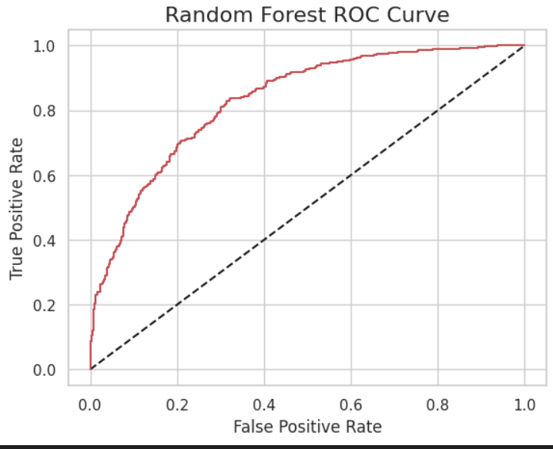
Through the ROC curve, it is clear that our model performs a lot better than a random classifier.
Other algorithms have been explored in the Jupyter Notebook

Slide 18
THANK YOU

